Slide 1

Kyle Hagan
Bobby Strickland
Megan Weaver
Jonathan Tashakori

Slide 2
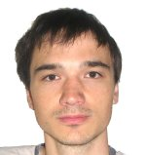
TimeFinder
Peter Karich
TimeFinder developer
German Physicist
Only TimeFinder contributor

Slide 3
TimeFinder
Created in NetBeans
Mavenized project, uses XML
Compatible with Linux, Windows, Mac
Written in Java
Tests written in Junit
Uses Spring Rich client in its Swing UI

Slide 4
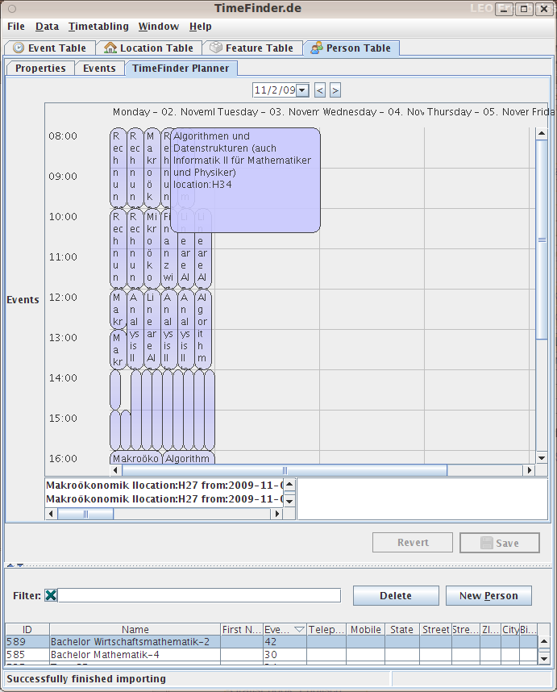
TimeFinder

Slide 5
TimeFinder
Experiences and Lessons Learned
Online Video Demo
Subversion repository
Mercurial (non-Mavenized version)
Swing Explorer
Fest / Spring Rich Client

Slide 6
TimeFinder
Test Plan
Unit Testing
  Person module
  Location module
  Event module
System Testing
  Schedule creation

Slide 7
TimeFinder
Fault Injection
JUnit
Unit test faults
  Person
  Location
System test faults
  Optimization
  Conflict Matrix
  Minimize Gaps

